Slide 1
AT&T Zoning Maps for OML01864(Relo for OM05185) RF Design 08/10/2023

Slide 2
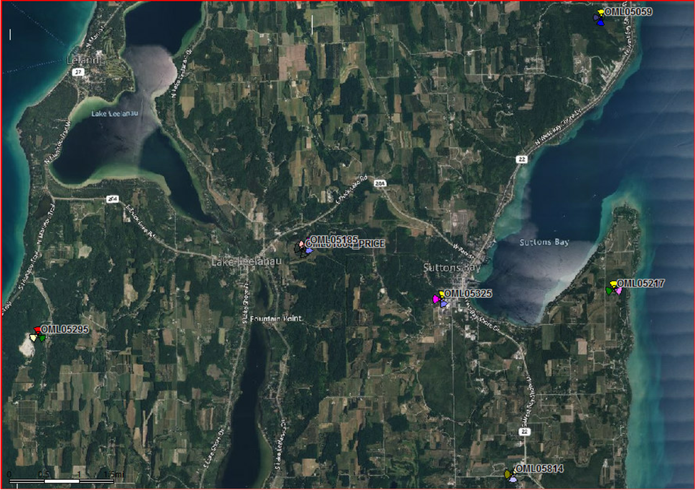
Area satellite Map

Slide 3
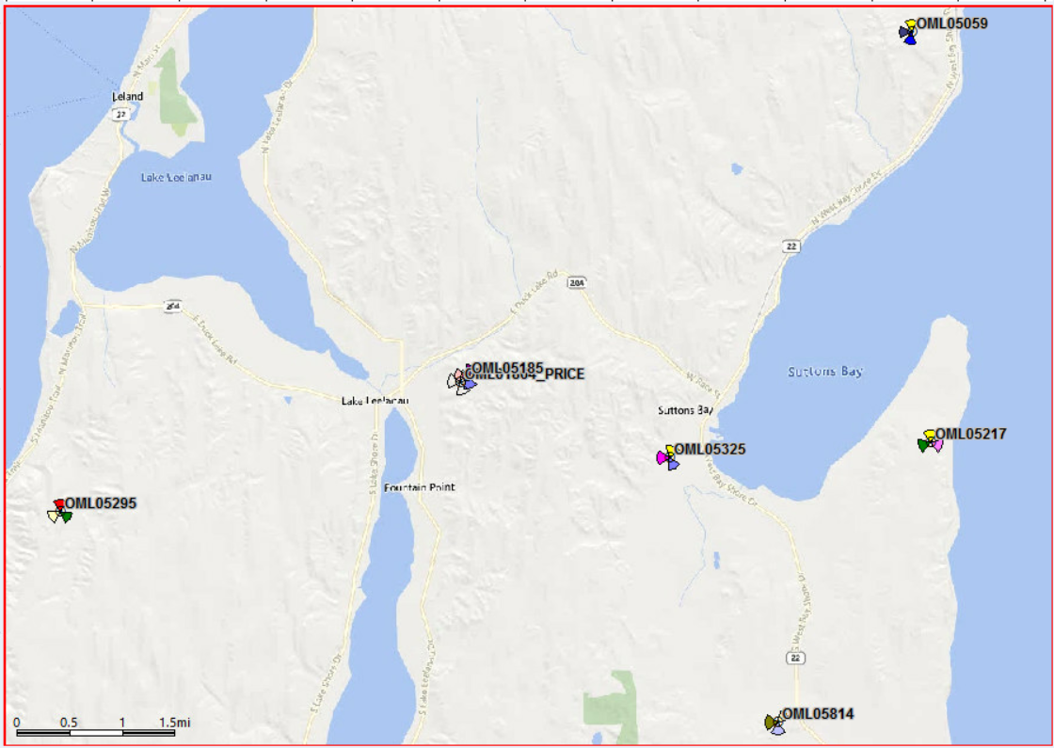
Street View

Slide 4
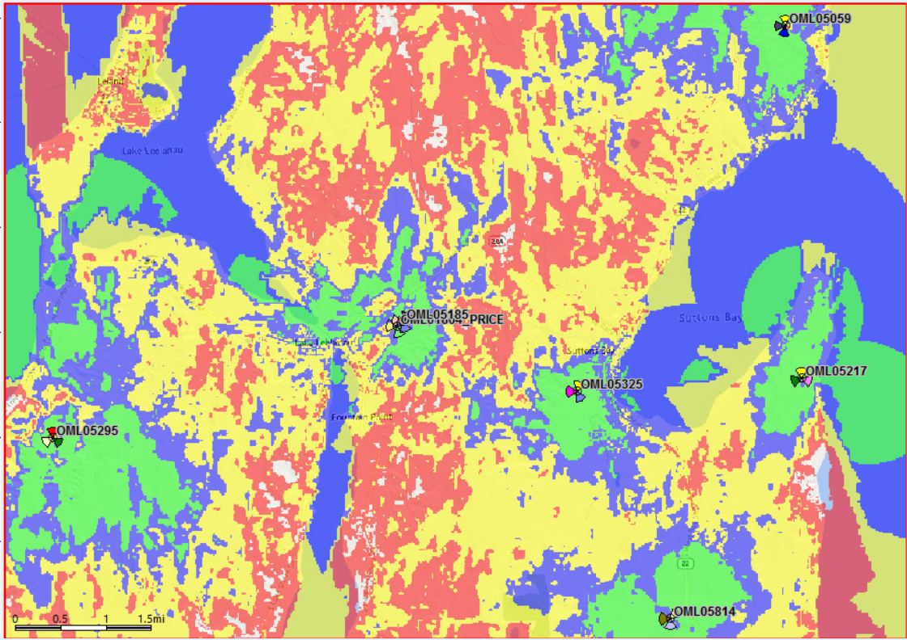
AT&T In door LTE Existing Coverage

Slide 5
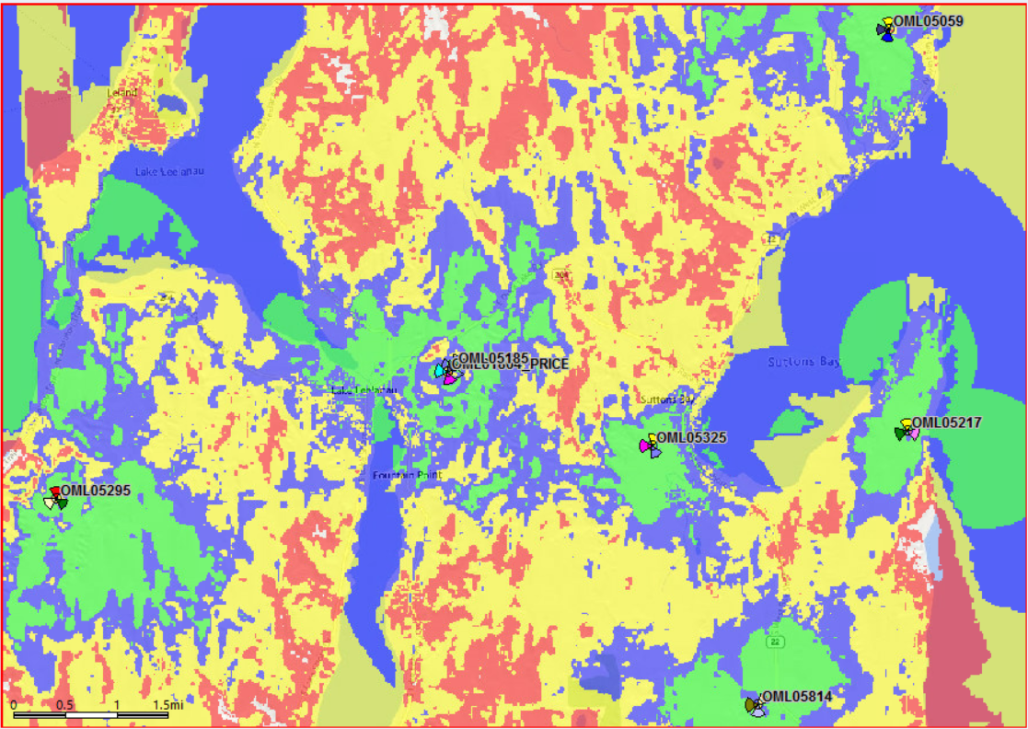
AT&T In door LTE Coverage with OML01864 Active AT 285’CL

